Slide 1
UNIT III – OpenFlow, Programmability and the Management Interface
UNIT I – SESSION 1
SESSION 8
  Service Locations and Chaining
  Non-ETSI NFV Work- Middlebox Studie
  Reference: Ref. 2, Ch.7 (Page No. 217 to 219)
  Ref. 2, Ch.7 (Page No. 228 to 231)

Slide 2
Service Locations and chaining
The concept of service chaining shouldn’t assume the service elements are located in a data center (or that all the service elements are virtualized), even though this may be a long-term goal of service providers for their edge/access deployments.
Services may be naturally associated with network boundaries, for example, by attaching a security policy to a network boundary or by inserting a load balancer at a network boundary.
This network boundary may be:
The boundary between a tenant network and an external network (the Internet or the VPN to the enterprise network)
The boundary between the network of one tenant and the network of another tenant
The boundary between multiple networks of the same tenant

Slide 3
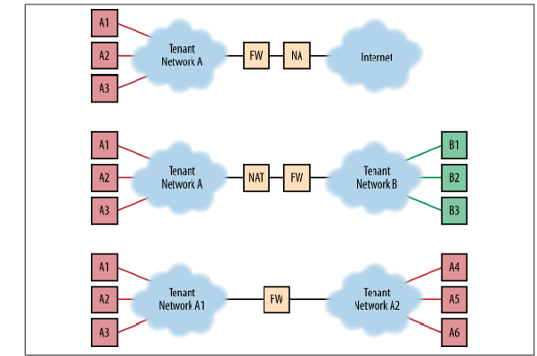
Services at Network Boundaries

Slide 4

Service Locations and chaining
Finally, services may be deployed in a more finely grained fashion and be attached to individual flows or groups of flows (i.e., aggregate flows).
This is the major model of interest for cloud service providers and in the Edge/Access network domain per-subscriber services.

Slide 5
Applying services to flows of traffic involves several steps:
1. Defining the elements and the ordering and configurations required to implement a service. This definition includes the constraints on the placement of service elements.
2. Identifying and steering the flow of traffic to visit the service node or the sequence of service nodes.
3. Vendors have begun to label their current methodologies for doing service chaining. In the case of Cisco Systems, this is called vPath, and in the case of Juniper Networks, The Service Engineered Path (SEP).
4. Control plane signaling to the service nodes to inform them which services to apply to which flows, including the service parameters.
5. There are also optimizations possible around original placement of the service node and/or the ongoing placement of additional service instances to alleviate performance bottlenecks

Slide 6
All of these tasks are well suited for an SDN controller.
SDN controllers have domain/ network-wide views of topology, hooks to orchestration systems (API), and the ability to manage/provision a network overlay.
The use of an SDN controller may seem to be an obvious conclusion in the context of service chaining in the data center, but less so in the Edge/Access domains.
This brings us back to the idea of an embedded controller, shown in Figure.
In a mixed environment (i.e., virtualized and legacy service elements) or an entirely legacy environment, the elements may not support some of the tunnel encapsulations used in SDN overlays or a native agent that pairs well with the SDN controller.
Thus, a mixture of VLANs and tunnel encapsulations, as well as configuration/control protocols between controller/controllers and network elements, may be required to create service chains

Slide 7
Non-ETSI NFV Work
The existence of the ETSI workgroup shouldn’t imply that this is the only place service virtualization study and standards are being conducted. For example:
The academic community is beginning to study some of the questions around NFV as part of the burgeoning SDN research they are performing.
Many existing controller/framework vendors are targeting service chaining as one of their applications and a few startups (e.g., LineRate, Embrane) are positioning controllers for layer 2 through layer 7 that work with their own virtualized services.
Existing vendors of highly integrated network elements are investigating intermediate or total virtualization of their platform/solutions.
IETF has begun soliciting interest in the area of service chaining. A proposed work group (Network Service Chaining [NSC]) is currently collecting drafts in its BoF (birds of a feather) stage.
This includes drafts proposing formalized packet headers for expressing service context and metadata as well as the need for a standardized generic service control plane

Slide 8
Middlebox Studies
In the academic community, recent studies have focused on optimization of Middlebox appliances, which are essentially the virtual service appliances (or a subset) targeted by NFV studies.
In particular, the studies focus on the ability to integrate, manage, and scale a complete Middlebox deployment, with the recognition that these could be more than one device—a service chain.
The University of Wisconsin has a progression of studies (Stratos,20 which appears to progress as CloudMB21) that propose optimizing performance of such chains by monitoring serviced streams based on an application-reported performance metric and (using a greedy heuristic) spinning up or down instances of specific middleboxes to alleviate bottlenecks (triggered by significant change in performance over some time threshold) while maintaining a pre-determined level of application performance.

Slide 9
Middlebox Studies
The study is also concerned with optimizations of the initial middlebox placement, the heuristic (scale) and in-flow assignment to the middleboxes such that inter-rack traffic was avoided as an additional bottle‐ neck source
There was also emphasis on not moving existing flows (no service interruption or make_x0002_before-break behavior) in the scale up/down phases.
The operator would prefer not to manually intervene at all (fully automated solu‐ tion) and that the nature or function of the middlebox was somewhat irrelevant to the process.
The preferred solution to congestion in the service chain can be solved in place (relatively), without diverting or “trombone(ing)” traffic to an instance or chain segment in another location (i.e., minimizing branching).

Slide 10
Middlebox Studies
The assertion that monitoring can’t be derived from traditional traffic counters in the infrastructure because of the nature of operation of some of the devices. Nor can the simple monitoring of resource consumption in the VMs be assumed to reflect end-to-end application performance. Thus, application involvement in monitoring is preferred.
The iterative heuristic was chosen over other strategies: scaling all middleboxes in the path, reliance on function-specific monitoring, reliance on packet processing time estimates, and monitoring CPU load on the service elements.

